Slide 1
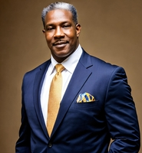

Welcome
District 6970 Governor Dale Moe
President Rotary Club of North JAX
2019 – 2020
District Rotaract Co-Chair 2017 – 2021
Founder and Charter President Rotary Club of Northwest JAX 2021 – 2022
District 6970 Governor 2025 – 2026
Retired U.S. Navy Chief Petty Officer, active Commercial Realtor

Slide 2
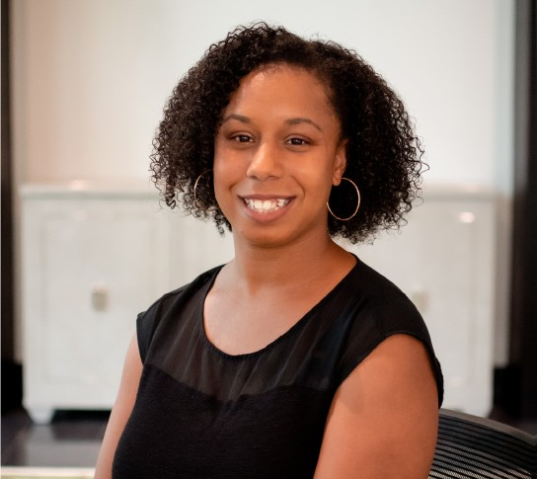
Membership inspiration
Why membership matters
District 6970 Rotaract Focus Person for the Membership Committee
Over five years of professional experience in the event industry
Actively involved in Junior Service League of DeLand, current Chair of Grand Marshals for the 2026 Wild Wild West event
Home club, Rotaract Club of DeLand
Served 2 years as Club Membership Chair
Chanelle Taylor

Slide 3

WHAT’S IN IT
FOR ME?

Slide 4
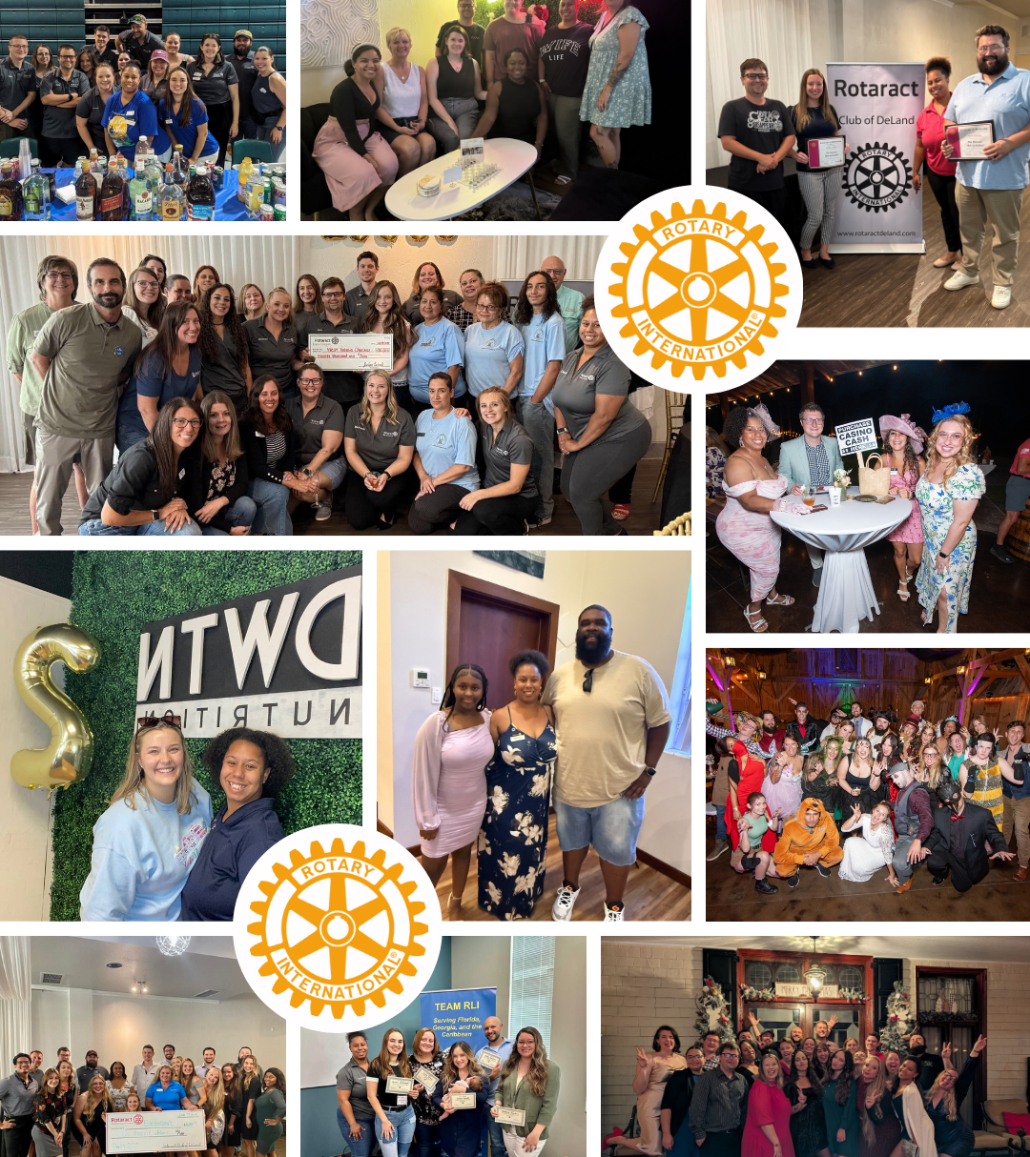
WHY I JOINED, WHY I STAY
Found my People, Purpose & Path
Leadership + Service + Lifelong Friendships
Grew from MEMBER to
MOVEMENT-MAKER

Slide 5



WHY IT ALL STARTS WITH MEMBERS
GROWTH
SUSTAINABILITY
INNOVATION
MORE IMPACT
MORE REACH
FUTURE LEADERS
LEGACY
NEW ENERGY
FRESH IDEAS

Slide 6




People & Connections
“You’ll find your tribe here”
Networking, Mentorship, Lifelong Friendships
Purpose
“Be part of something bigger than yourself”
The chance to make a local & global difference
WHAT MAKES PEOPLE SAY YES?
Personal Growth
“Skills for life, not just Rotary”
Leadership, Public Speaking, Confidence, Service Learning
Opportunities to Lead & Shine
“Rotary gives you the stage to step up”
Projects, Events, Causes → YOU get
to drive change!

Slide 7

MEMBERSHIP AS OF 1 JULY 2025:
ROTARY
1,124,681
36,358
27%
57
ROTARACT
132,296
9,550
46%
26
1,124,681
132,296
Members
Clubs
Women
Average Age
36,358
9,550
27%
46%
Women
Average Age
57
26
Notes:
Note: If you give this presentation after 1 January 2026, consider retrieving updated figures from Rotary Club Central.
Here’s a look at our membership numbers As of 1 July:
Rotary club membership was more than 1.12 million. This represents a net loss of about 9,600 members overall.
Rotaract has more than 132,000 members in 9,500 clubs. It’s exciting to see the increase in both Rotaract members and clubs!
Rotaract has achieved virtual gender parity, with women as 46% of members. Women represent 27% of Rotary club members.
In Rotary, we have seen an increase in members under 40 years old as well– of those who share their ages, they represent 15% of our total membership.

Slide 8
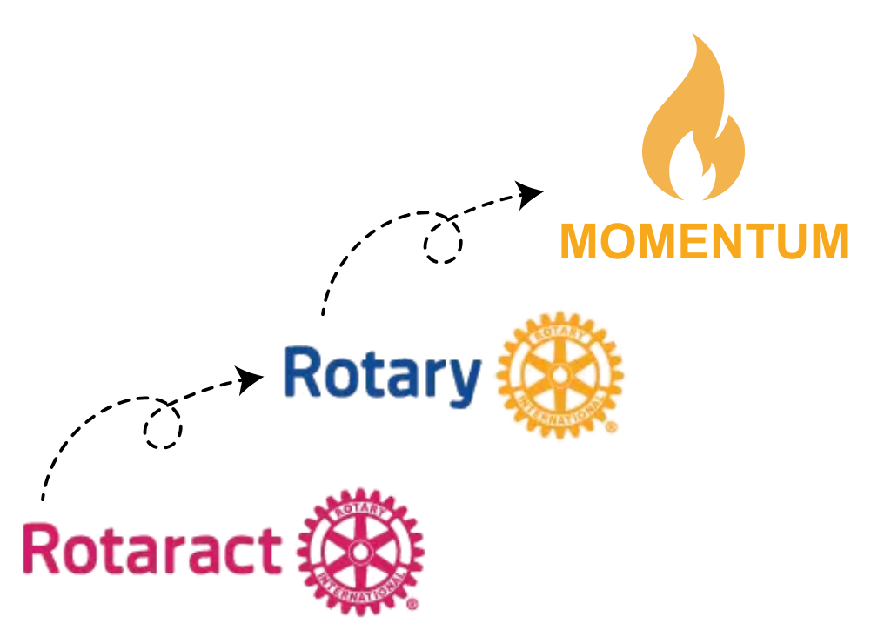
HOW TO KEEP THE SPARK ALIVE
Feeling Valued & Seen
Fun + Impact
Mentorship & Belonging
Room to grow into leadership
A clear path from Rotaract → Rotary
“Who’s the next Rotaractor you can invite into your club’s future?”

Slide 9
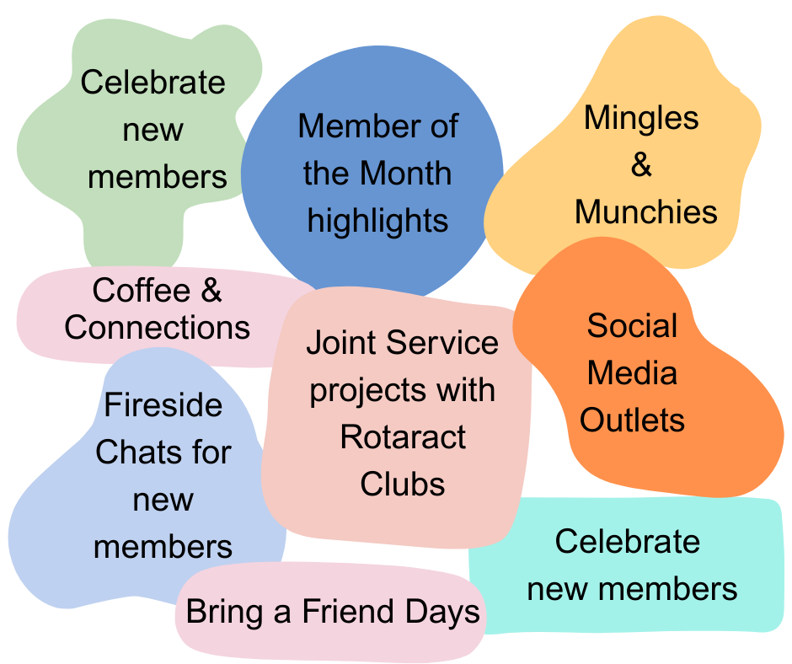
Quick Wins
=
Member Magic

Slide 10
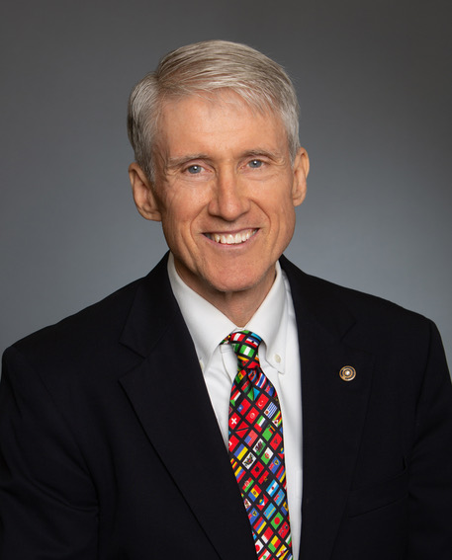
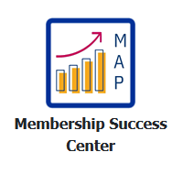
District Membership Chair 2015 – 2019
District Governor 2019 – 2020
Zone 34 New Club Coordinator (ICA)
2020 – 2023
Zone 34 Rotary Membership Coordinator 2021 –2024
Home Club South Jacksonville
MikeHDarragh@gmail.com
Rotary Club Dynamics
PDG Mike Darragh

Slide 11
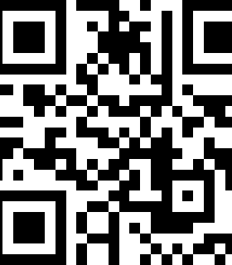
Accessing the Membership Success Center & goal setting instructions

Slide 12
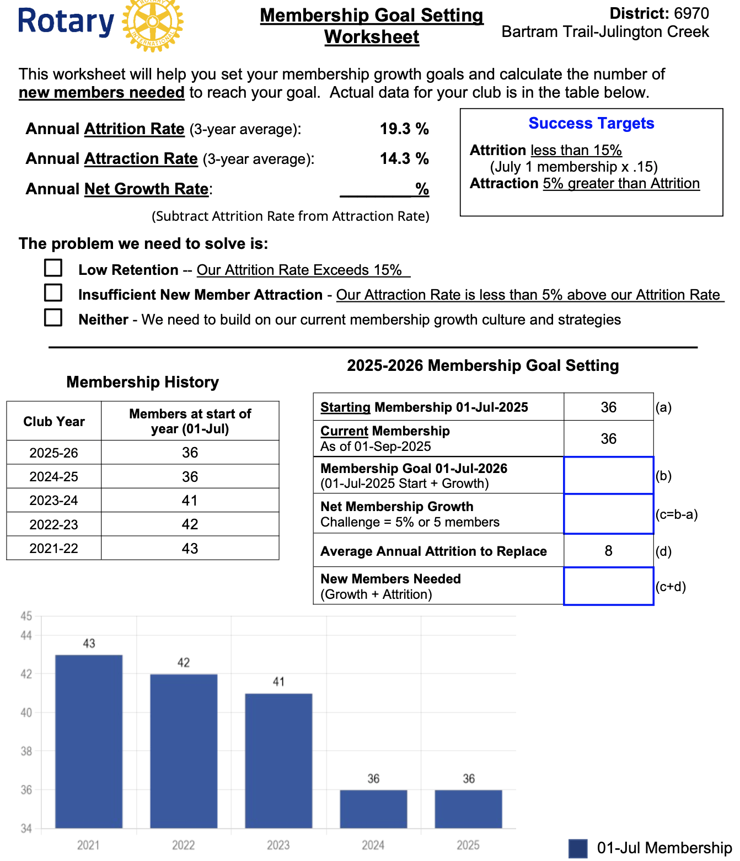
subhead
Club of Somebody’s
43
42
41
36
36
2021
2022
2023
2024
2025

Slide 13
subhead
Club of Somebody’s
43
42
41
36
36
2021
2022
2023
2024
2025

Slide 14
subhead
43
42
41
36
36
2021
2022
2023
2024
2025

Slide 15
QUESTIONS

Slide 16
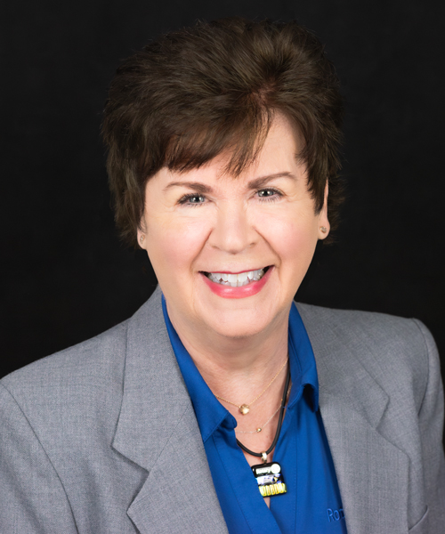
Discover rotary opportunities
Mary Stutts
  District 6970 Membership Chair 2024 – 2026
  District Innovative Club Advocate, District
  Membership Committee Member 2022 – 2024
  Champion for the Satellite Club of Oceanside
  Rotary 2022
  Area 7 Assistant Governor 2019 – 2022
  Jacksonville Oceanside Club President 2017 – 2018
  Home club Jacksonville Oceanside, BOD and Club Membership Chair
  mdstutts@comcast.net

Slide 17
"Discover Rotary" refers to two main things within the Rotary organization: a specific event format for introducing potential members to Rotary's activities and values, and a broader initiative to share information and resources about Rotary to attract new members to the organization
Title Page Option

Slide 18
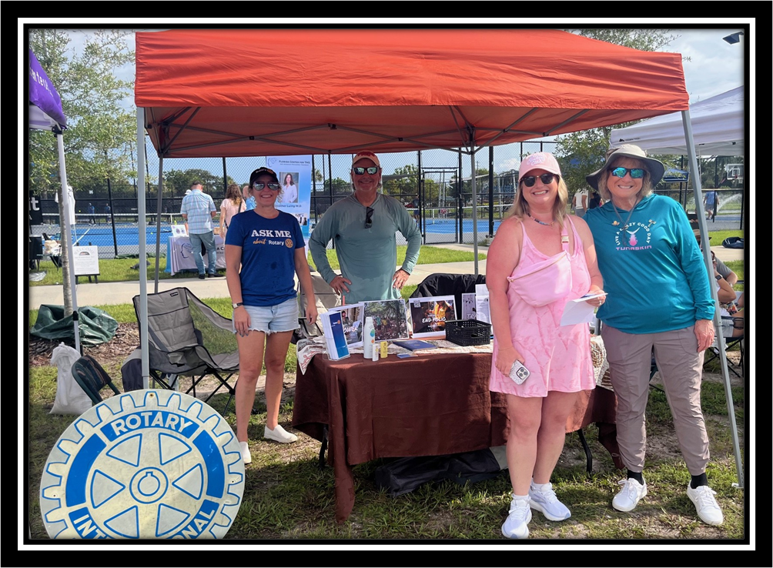
Discover Rotary
  Who is involved?
  What is the budget?
  What is the timeline?
  What type of event to hold?
The basic questions

Slide 19
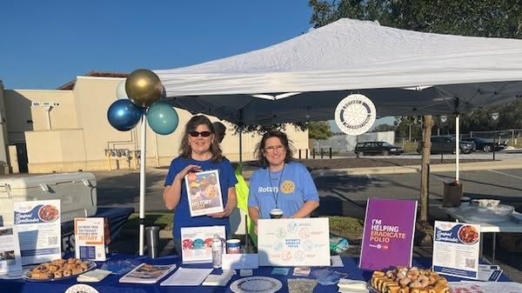
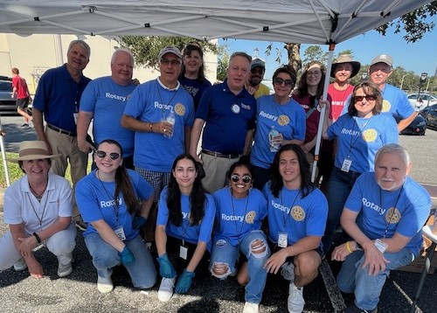
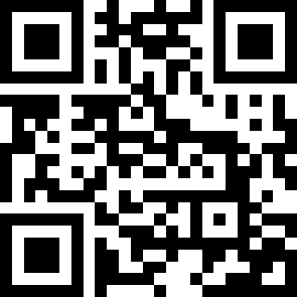
Volunteer at a Community event
Example: Assist in ensuring a community event runs smoothly; support the coordination and flow of the event
Pros
  Demonstrates service and community support
  Potential for high visibility
  Low cost to participate
Cons
  Challenge to capture attendee interest

Slide 20

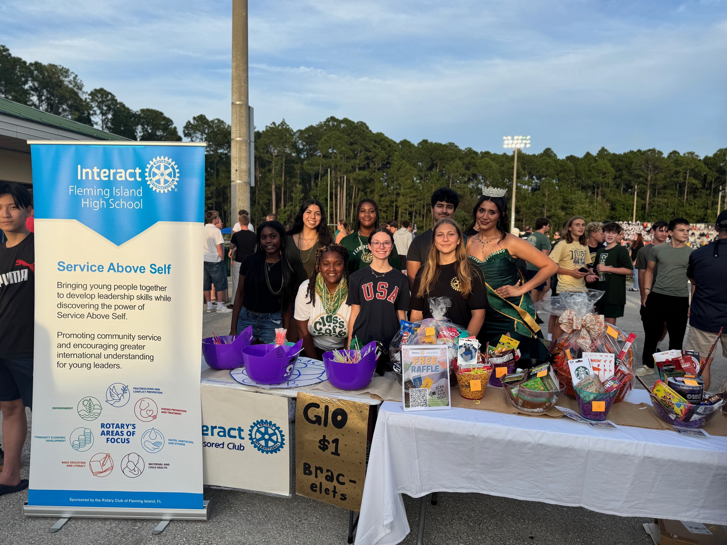
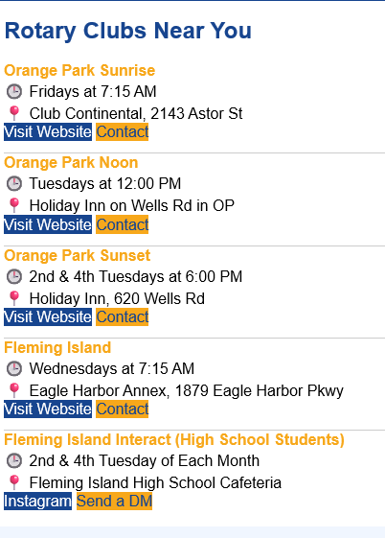
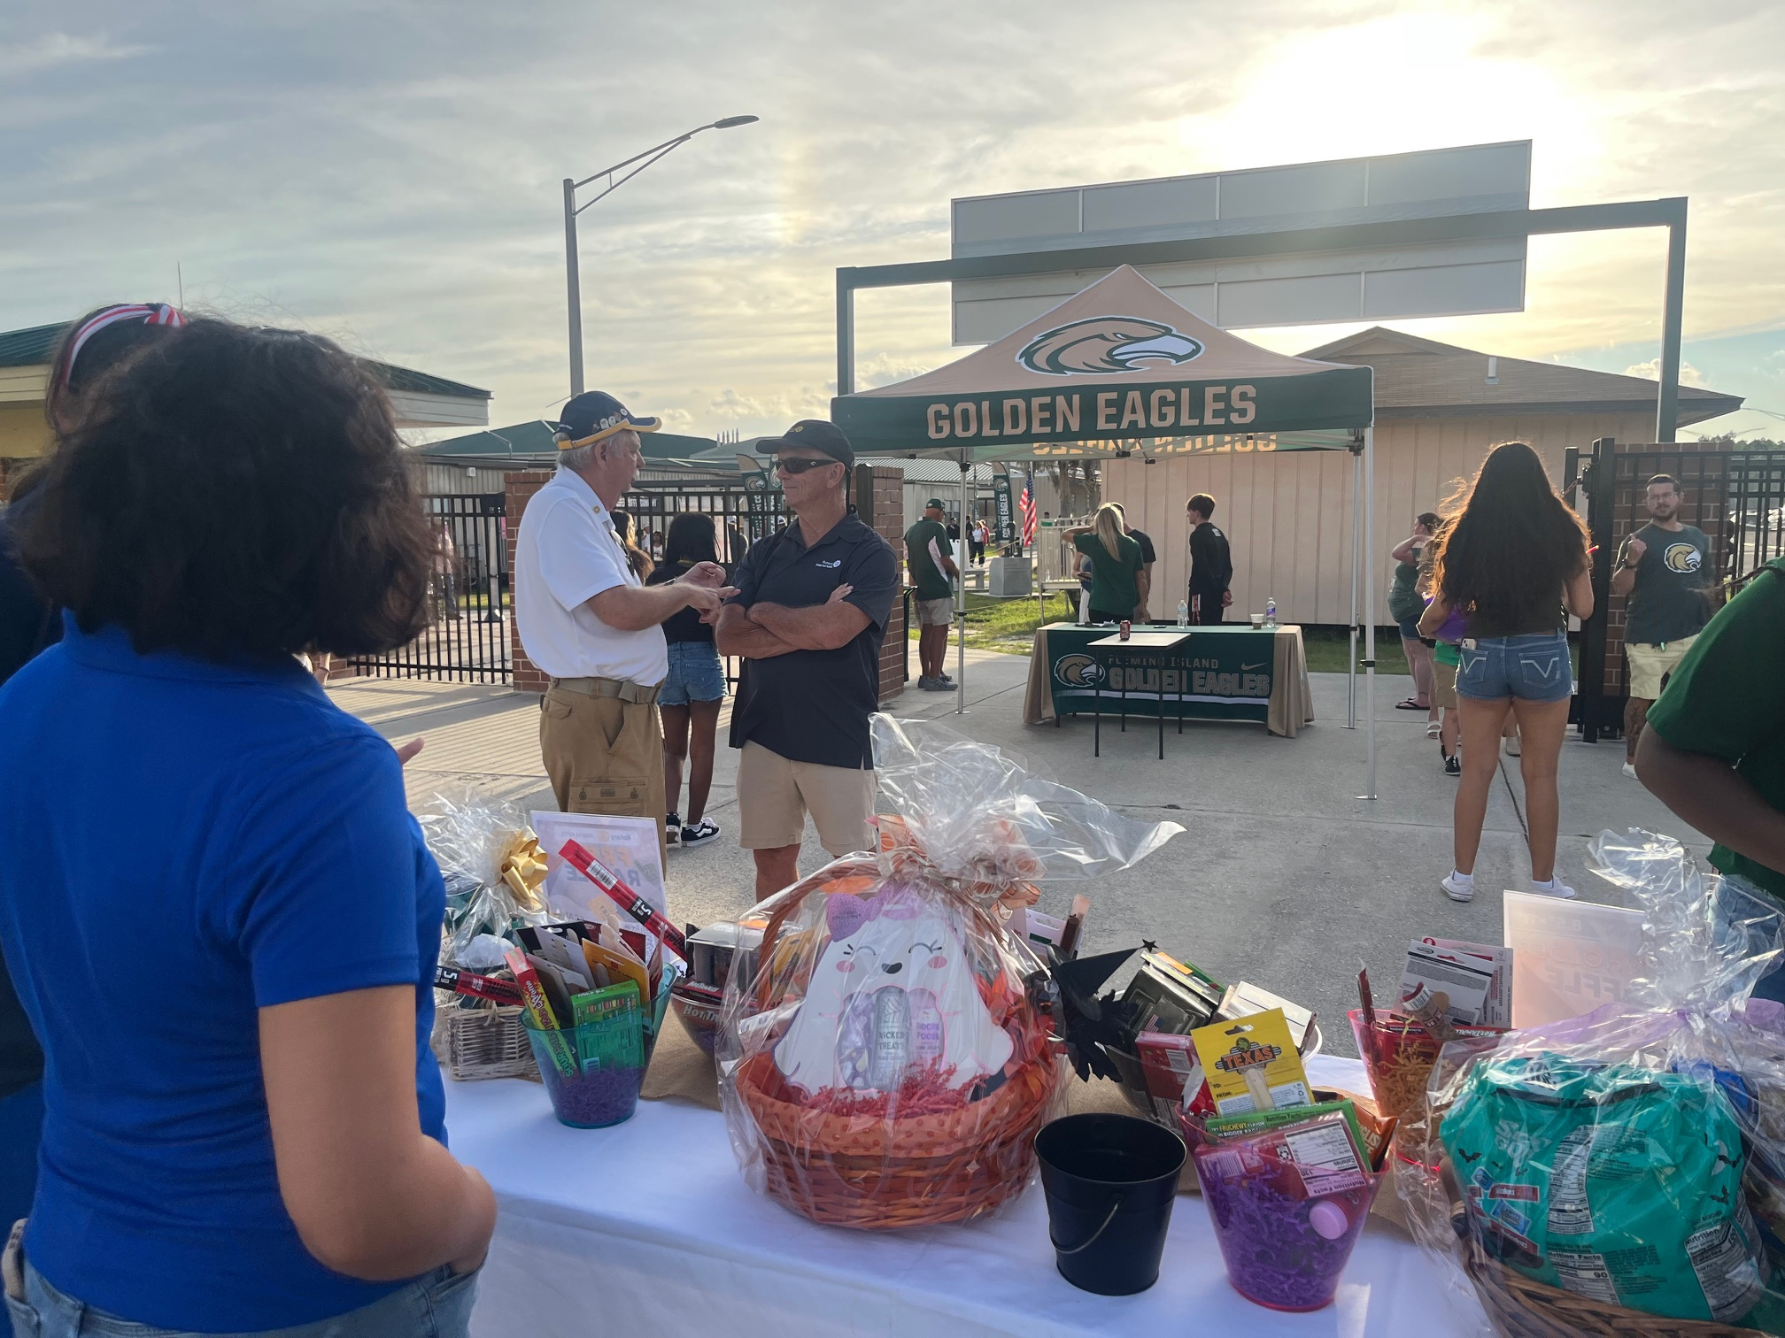

Volunteer at a Community event

Slide 21
HosT a member prospect event
Have fun!
Share details of participating clubs and membership types
An opportunity to talk about the amazing initiatives of the Rotary Foundation
Share club passions and positive impacts on the community and the world
Example: Secure a local venue and invite guests of members and warm prospects in the membership pipeline
Pros
  Ability to showcase your club’s culture
  Impactful follow-up for warm prospects and new members in one event
  One-on-one dialogs that are comfortable for all
  Opportunity to incorporate technology
Cons
  Expense

Slide 22
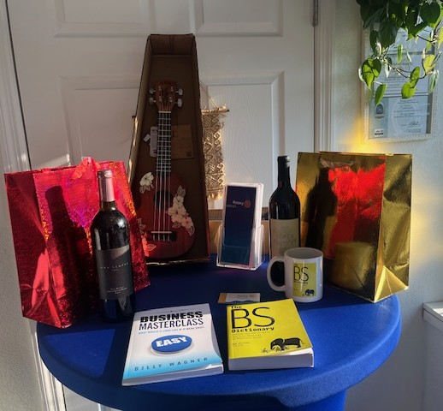
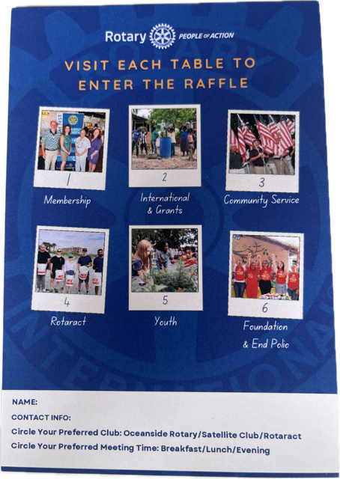
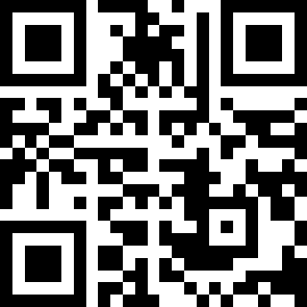
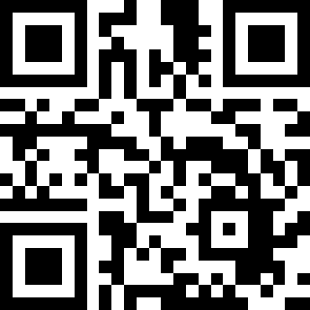
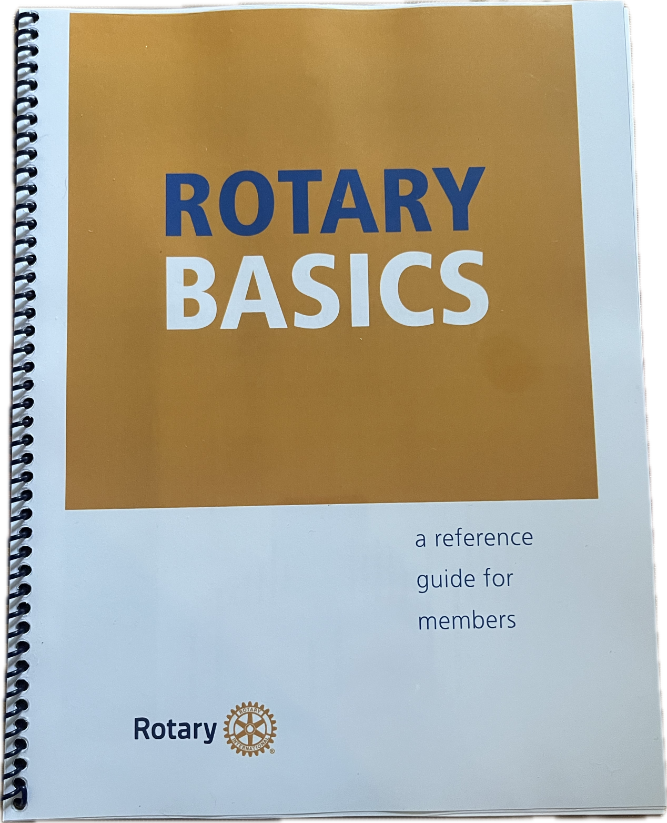
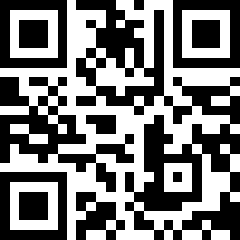
Host a member prospect event
Customizable PPT
Compelling Rotary.org videos
Rotary “how to” guides

Slide 23


WELCOME
Notes:
Welcome everyone to the event.
Before we get started we have a short video to play about Rotary and why Rotarians consider themselves “People of Action”

Slide 24

DISCOVER
WHO WE ARE | WHAT WE DO | LOCAL IMPACT
Notes:
We hope you enjoyed the video. Today we will dive a little deeper into Who We Are, What We Do and our Local Impact, but first let’s get to know one another.
Ask everyone to state their name & professional background even if they are retired.
Members: What attracted you to Rotary & why do you stay?
Guests: What brought inspired you to join our discover Rotary event today?

Slide 25
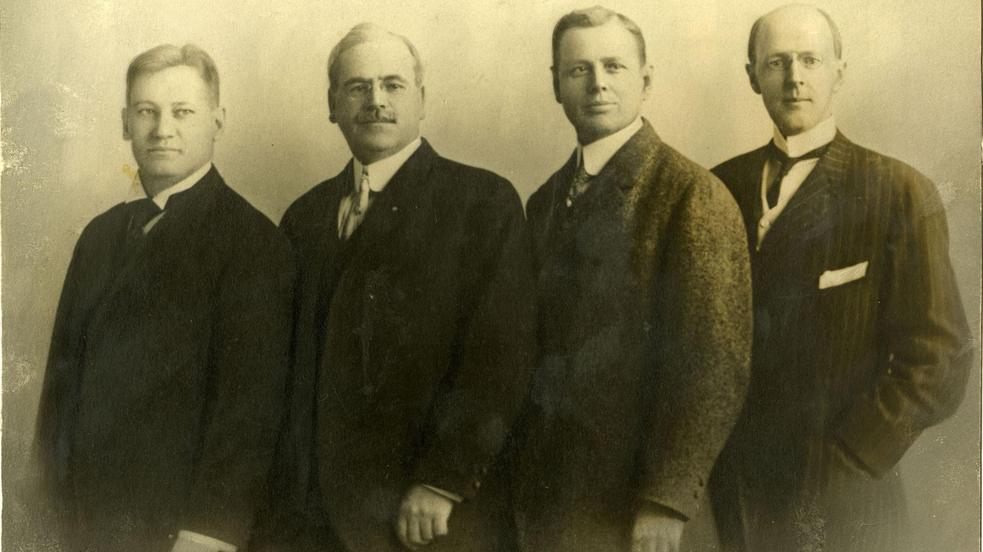
Gustavus Loehr
Silvester Schiele
Hiram Shorey
Paul Harris
|
WHO WE ARE
Notes:
On 23 February 1905, Paul P. Harris, Gustavus Loehr, Silvester Schiele, and Hiram E. Shorey gathered in Loehr’s office for what would become known as the first Rotary club meeting.
Harris’ desire for camaraderie among business associates brought together these four men and eventually led to an international organization of service and fellowship.
Since 1905, grown from 4 Rotarians in Chicago to 1.4 million Rotarians in 220 countries around the world.

Slide 26
TOGETHER,
WE SEE A WORLD
PEOPLE
WHERE
UNITE AND TAKE ACTION
CREATE
TO
LASTING
CHANGE
ACROSS THE GLOBE,
IN OUR COMMUNITIES, AND IN OURSELVES.
|
OUR VISION
Notes:
We are a non-denominational and non-political organization comprised of community leaders who share a commitment to enhance our local community and communities throughout the world. We help people in need with today’s most pressing challenges.

Slide 27
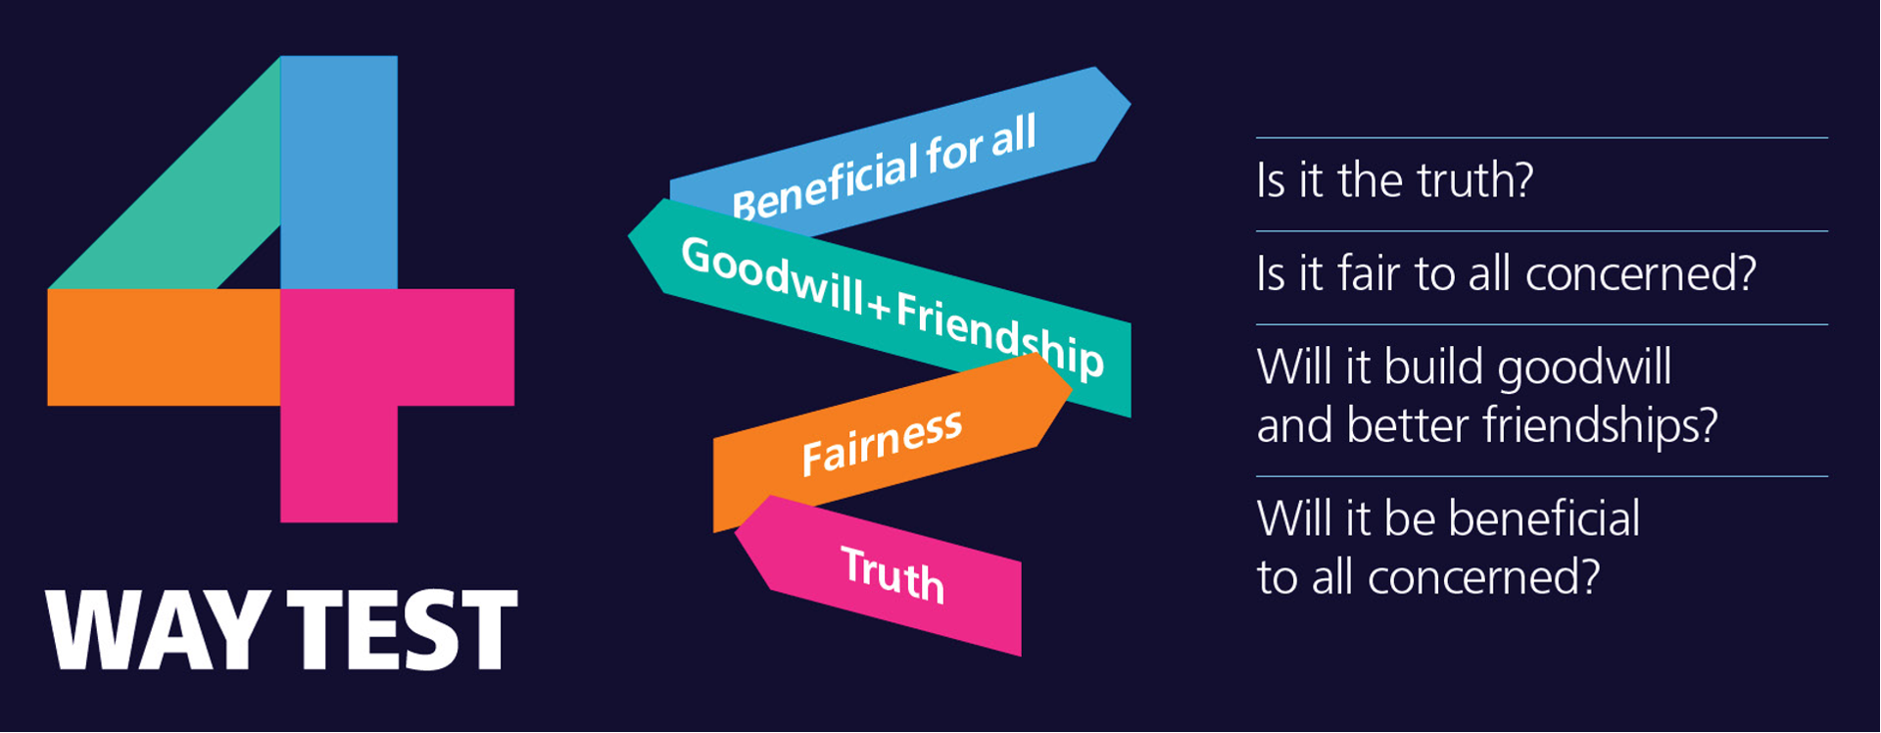
|
SERVICE ABOVE SELF
Notes:
Our motto is “Service Above Self” – let that sink in for a moment
At meetings you will often be asked to join in reciting our 4-Way test
This is the litmus test that Rotarians should apply to their thoughts, what they say and their actions.
Let’s practice, join me in the 4-way Test of the things we think, say and do
Is it the truth?
Is it fair to all concerned?
Will it build goodwill and better friendships?
Will it be beneficial to all concerned?

Slide 28


|
WHAT WE DO
Notes:
Rotary’s non-profit foundation, The Rotary Foundation focuses on “Doing Good in the World” as it promotes world understanding and peace.
It has received from CHARITY NAVAGATOR their highest rating of Four Star for 15 consecutive years.
It has earned this recognition for adhering to sector best practices and executing its mission in a financially efficient way, demonstrating both strong financial health and commitment to accountability and transparency.
Since it was founded at the 1917 Convention, more than 107 years ago, the Foundation has spent more than $4 billion on life-changing, sustainable projects that support our Seven (7) Areas of Focus.

Slide 29

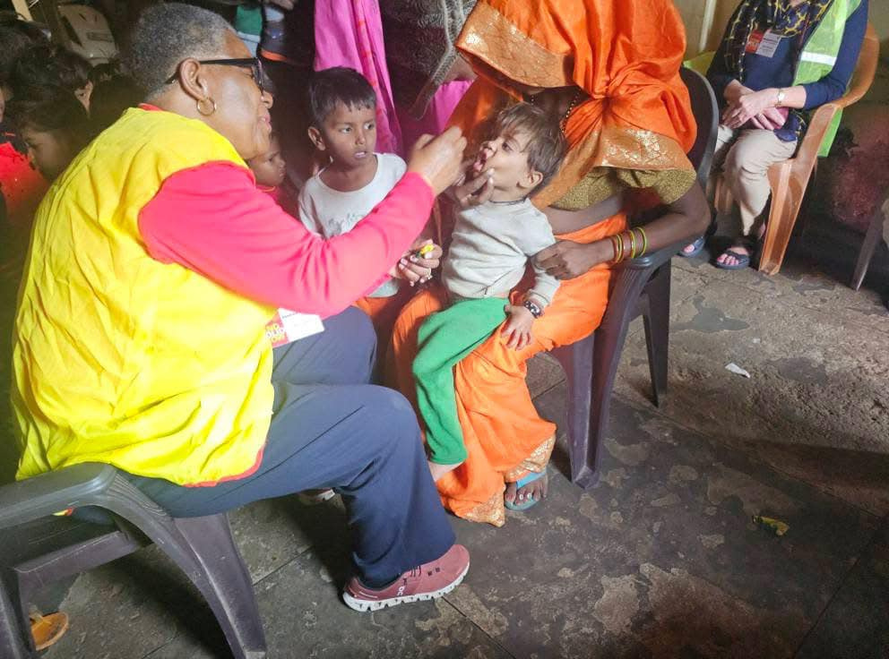
|
WHAT WE DO
Notes:
Rotary has been working to eradicate polio for more than 35 years. Our goal of ridding the world of this disease is closer than ever & END POLIO NOW is Rotary’s #1 PRIORITY.
As a founding partner of the Global Polio Eradication Initiative, we've reduced polio cases by 99.9 percent since our first project to vaccinate 6 million children in the Philippines in 1979.
Rotary members have contributed more than $2.1 billion and countless volunteer hours to protect nearly 3 billion children in 122 countries from this paralyzing disease.
Rotary’s advocacy efforts have played a role in decisions by governments to contribute more than $10 billion to the effort.
Today, the wild polio virus remains endemic in only Afghanistan and Pakistan with only six cases in Afghanistan and six cases in Pakistan in 2023. But it’s crucial to continue working to keep other countries polio-free.
If all eradication efforts stopped today, within 10 years, polio could paralyze as many as 200,000 children each year.
Polio Plus was launched in 1985 and has resulted in a 99.9% reduction in the number of Polio cases world-wide.
The Bill & Melinda Gates Foundation joined Rotary in 2017 a commitment of $450 million to help End Polio.

Slide 30
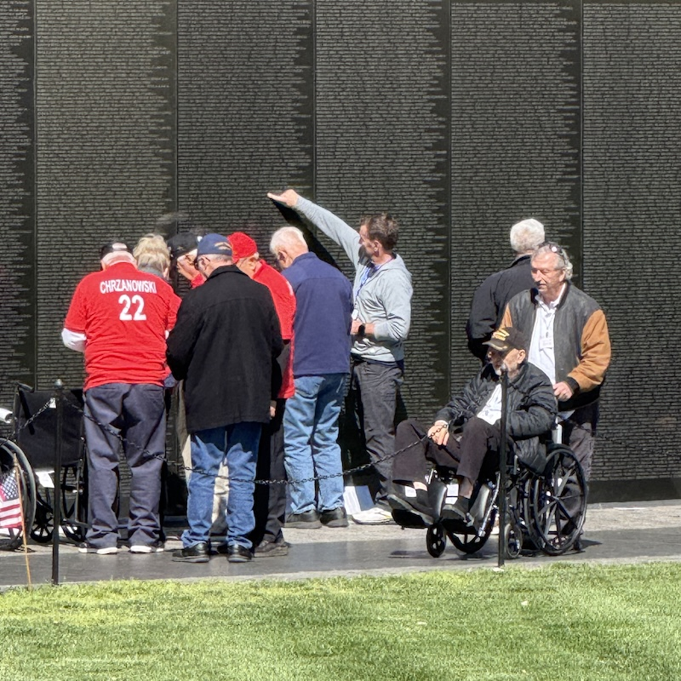




District 0000
Day & Time of Meeting
Location
|
LOCAL IMPACT
Notes:
Go to My.Rotary.org > Brand Center and create a simplified white & gold version of your club logo to replace the placeholder logo. Once you have your club logo, click on the place holder > Picture Format in the menu > Change Picture > Select your new logo file.
Get 3 (square 600x600) images that show your club in action. Use service projects, fundraisers and social events that you can talk about. Click on each of the circles, Go to Shape Format in the menu > Shape Fill > Picture to replace the image with one of your own.
Update the slide with your district & club info.

Slide 31
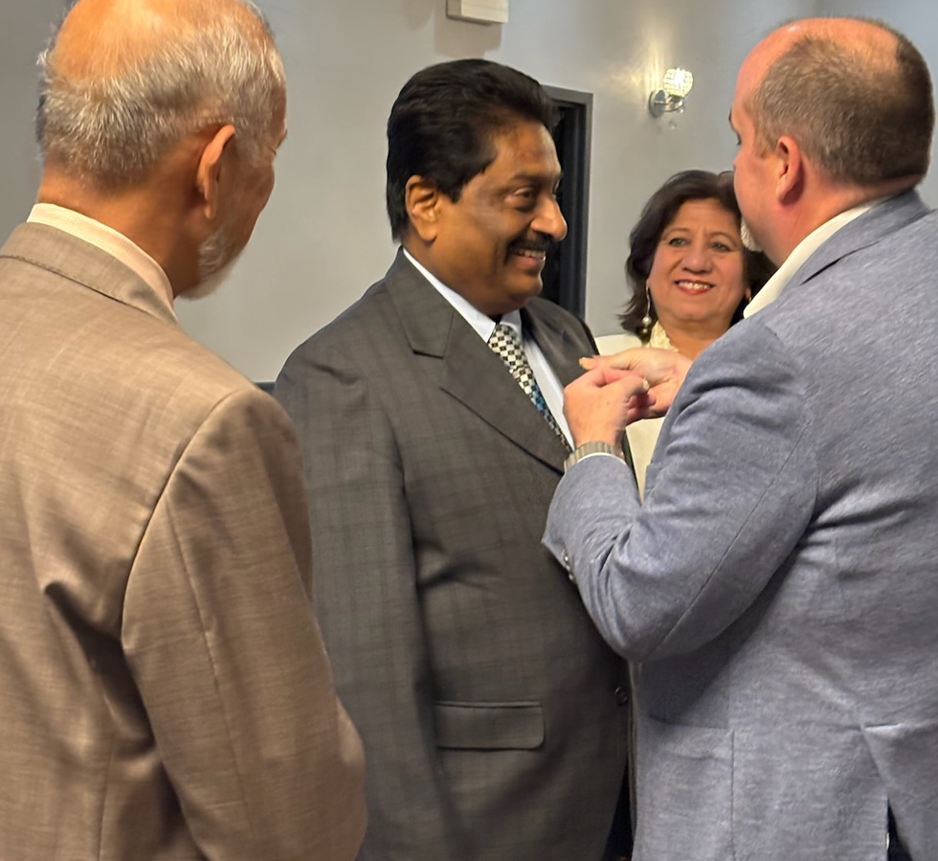





Life-Long Friendships
Service to Others
Professional Networking
Leadership Development
Personal Growth
“I joined Rotary to make new friends,
I stayed to change the world.”
|
WHY JOIN?
Notes:
There are many good reasons to join Rotary.
Life-long friends, Service to the community, networking, leadership development , personal growth, and, being part of something larger than yourself
These are just a few of the reasons why millions of people have joined Rotary.

Slide 32





Discover Rotary
Attend 3 Meetings
Application Process
Orientation
Induction Ceremony
|
JOIN OUR CLUB
Notes:
Be sure to replace the logo again and add three more pictures of your club in action.
Update the list of steps it takes to join your club. This is a good opportunity to set expectations for the process and time it will take.

Slide 33
Thank You!
|
QUESTIONS?
Notes:
Thank you for your interest in joining Rotary and in our local club.
What additional questions can we answer?

Slide 34
Take A
Break!

Slide 35
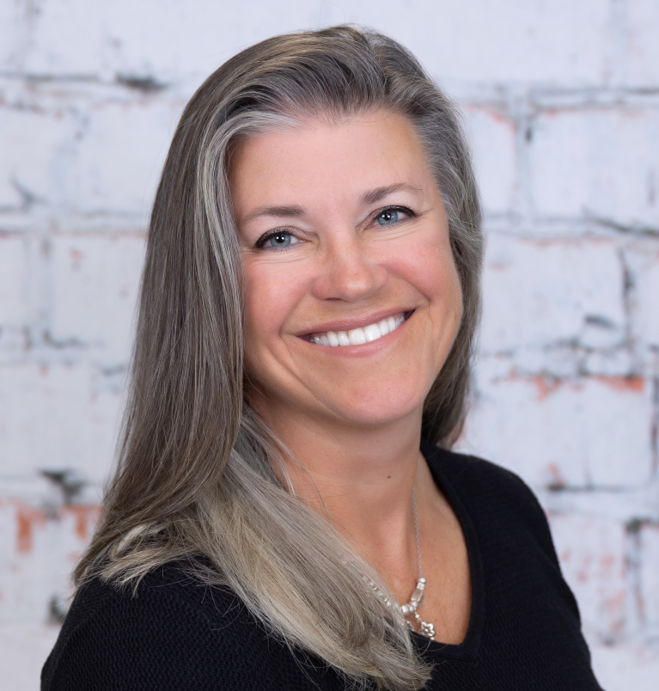
Building belonging from day one
Effective onboarding
District Membership Committee Member
Rotarian since 2007; currently Immediate Past President, Rotary Club of Amelia Island Sunrise
Downtown District Manager, City of Fernandina Beach 2025
Former Executive Director, Fernandina Beach Main Street Program
Former Assistant Scout Executive, Minsi Trails Council, Boy Scouts of America (Lehigh Valley, PA)
Former owner of Attick’s Inc., a family-run wholesale floral import business
Active in community service and nonprofit leadership
Lisa Finkelstein

Slide 36
Introduction & Session Framing
Purpose of the Session
Focus on improving member retention
Emphasis on intentional onboarding practices
Three Key Areas for Success
Orientation: Introducing new members to club culture
Induction: Formal process of welcoming members
Mentorship: Providing guidance and support
Key Message
Members join and leave clubs, not Rotary as an organization
Notes:
Brief personal intro and Rotary role
IPP and District Membership Committee
Rotarian since 2007
3 Clubs-Hazleton and Bethlehem in PA, AI Sunrise in FL
Professionally: owned and operated a wholesale floral supply business, spent 8 years with the BSA, and 4 years with FB Main Street and now the DT Manager for the COFB
Purpose: Strengthening retention through intentional onboarding
Three Key Areas: Orientation, Induction, Mentorship
Key message: “Rotarians join and leave clubs—not Rotary.”

Slide 37
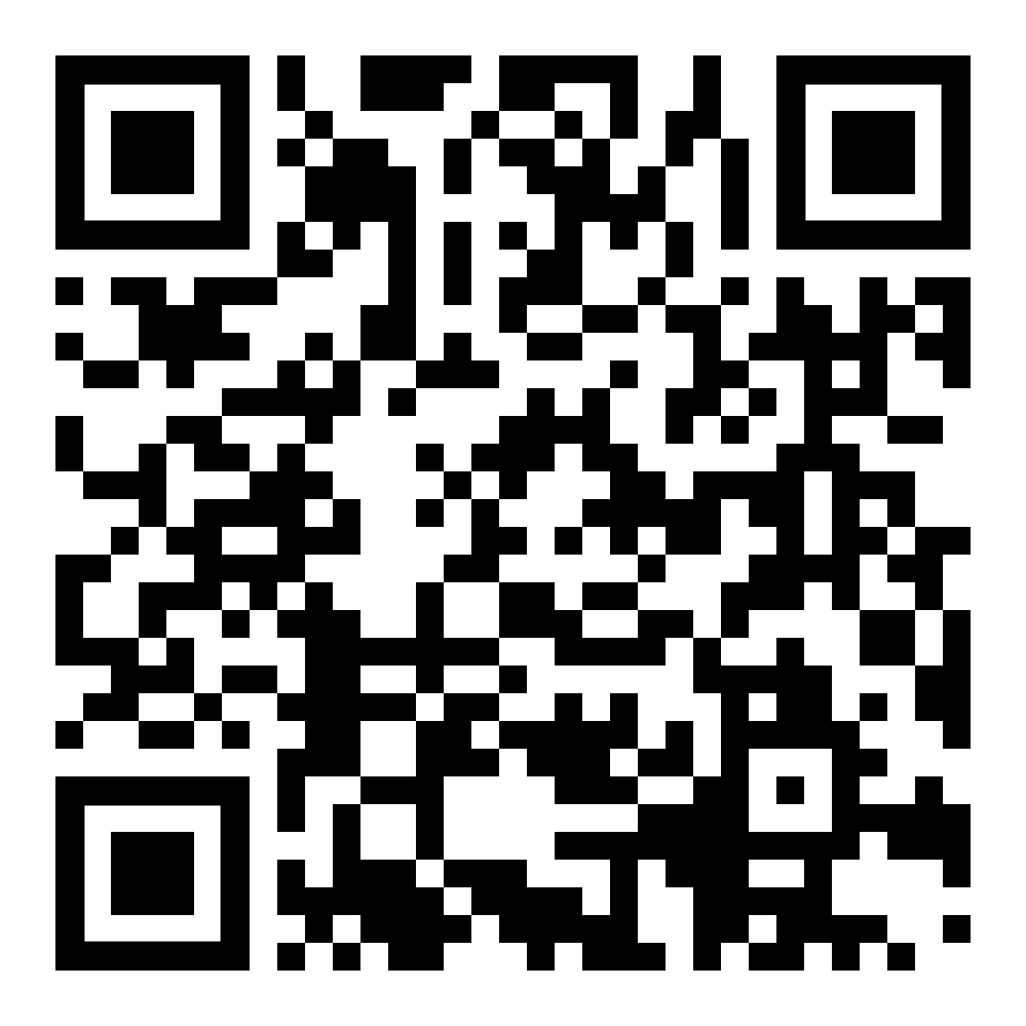
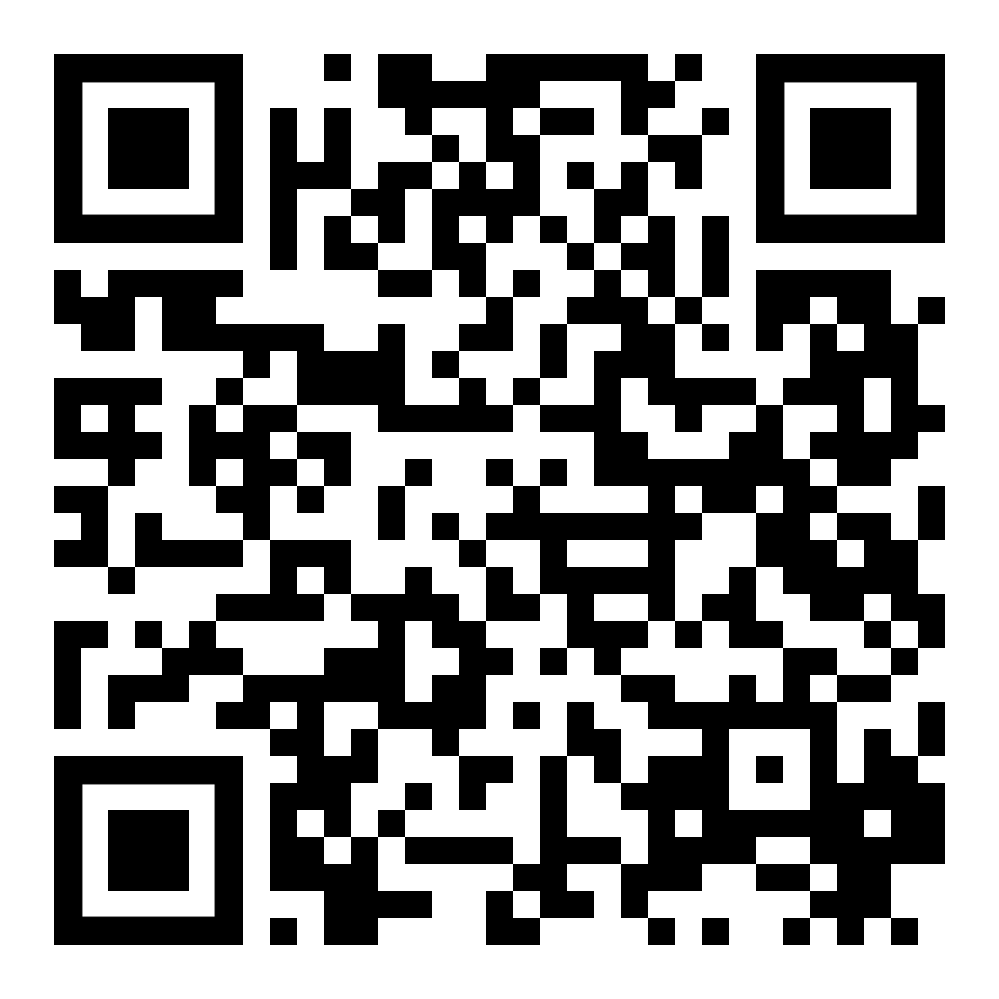
Key Components of Orientation
Pre-Induction Activities
  Rotary 101 session
  Fireside Chat
  FAQ document
Post-Induction Steps
  Profile setup
  Committee involvement
  Welcome packet
Onboarding Tools
  Rotary Z33-34 Toolbox
  My Rotary resources
  Branded materials
  Rotary Basics course
Zone 33-34 Toolbox
RC Amelia Island Sunrise
Notes:
Jump right in…
Pre Induction Purpose: Set realistic expectations around participation, activities, and cost
FAQ document on our website-QR link
One on one or post-induction in a group of new members (added advantage of forming relationships with Rotarians and spouses)
Key Components of Rotary 101:
History and Mission:
Founded in 1905, Rotary aims to promote peace, fight disease, provide clean water, support education, and grow local economies.
Structure:
Rotary consists of local clubs, districts, and international governance.
Each club operates independently but follows Rotary's core values and mission.
Membership:
Open to individuals from various professions and backgrounds.
Members engage in community service and networking.
Service Projects:
Clubs undertake local and international projects.
Focus areas include health, education, and community development.
Rotary Foundation:
A charitable arm that funds projects and initiatives worldwide.
Supports global grants and local community projects.
Presentation Tips:
Use visuals to illustrate projects and impact.
Include testimonials from members about their experiences.
Highlight specific projects to demonstrate Rotary's work.
Post Induction Purpose: Ensure immediate involvement and continued acceptance beyond the induction ceremony; GET INVOLVED!
DACdb Profile & contact with other members
Join a Committee-mandatory; meetings once per quarter at a meeting
Welcome Packet-valuable info and their Rotary pin; part of something larger than the individual or club
Tools: So many options and resources but the key is to find the ones that fit with your club’s personality; QR link to Zone 33/34 Toolbox

Slide 38
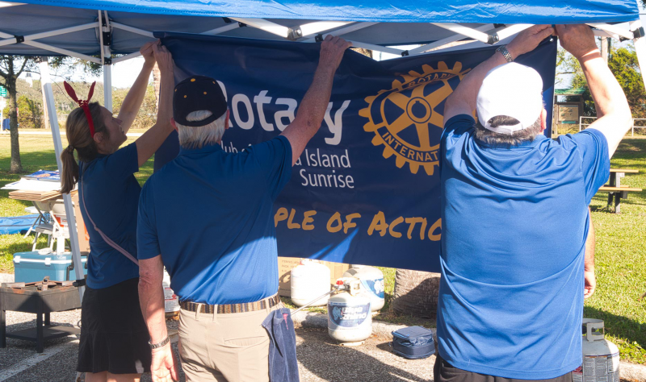
Engagement Tips for New Members
Personalize the Experience
  Utilize a new member survey to understand individual preferences
Assign a Buddy
  Pair new members with experienced ones for guidance
Early Involvement in Events
  Encourage participation in service or social activities soon after joining
Implement Feedback Loops
  Conduct regular check-ins at 30, 60, and 90 days
Notes:
To boost new member engagement, personalize their experience with surveys, assign a buddy for support, get them involved in events early, and use feedback loops like regular check-ins at 30, 60, and 90 days.
Discover their interests and talents
Do they already have Rotary experience
Were they drawn to the club for networking or service opportunities
Tailor their committee involvement accordingly
GIVE THEM SOMETHING TO DO!

Slide 39
Best Practices for Induction Ceremonies
Celebrate
Celebrate New Member Publicly
Use personalized music intro during club celebration
Share photos and updates on social media platforms
Introduce
Assign Speaking Role
Offer a speaking opportunity if the new member is comfortable
Provide two prompts in advance to help prepare
Testimonial
Include Testimonials
Share a short testimonial from the sponsor
Feature a testimonial from a recent inductee or special guest
Resources
Utilize Resources
Refer to sample script for the event
Use planning checklist
Notes:
To welcome new members,
celebrate with music and public posts, have all members stand
assign a speaking role with prompt questions provided ahead of time (profession, hobby, family, rotary experience, etc.)
include sponsor or inductee testimonials, have sponsor and new member stand at exit to be congratulated after meeting; hold inductions when AG, DG, or PDG is in attendance
use resources like scripts, checklists, and a Welcome Packet; keep it simple but treat it as a special moment; ceremony and tradition are important

Slide 40
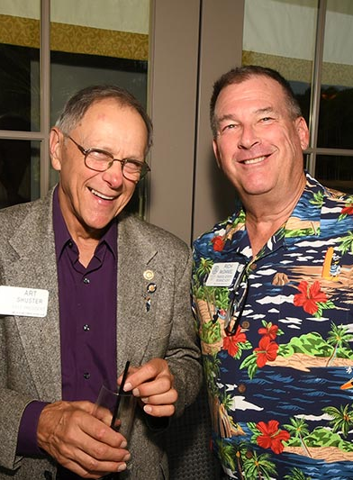
Structuring the Mentor Program
Assign a Mentor Before Induction
  Choose an engaged member
Provide Mentors with a Checklist or Guide
  Use Red badge/Blue badge lists
Set Clear Expectations for Mentors/Mentees
  Schedule three-month check-ins to track progress
  Offer a club tour to familiarize new members
  Introduce mentees to various committees
Notes:
To structure the mentorship process, assign an engaged member as mentor before induction. Suggest someone other than the sponsor so that new member has two connections in the club.
Give mentors a checklist; red/blue badge checklist is a good guide; gives new member a list of tasks and suggests that they complete a specific number of them (greeter, attend board meeting, make a polio contribution, etc.)
set expectations for regular check-ins, provide a club tour (sit at a variety of tables, review the website and where to find the club calendar, show them how to use Ignite or the email platform), and introduce new members to committees.

Slide 41
Why Mentorship Works
Mentorship Builds Connection and Accountability
Encourages Early Engagement and Retention
Supports Leadership Development
Bonus: Mentor-Mentee Service Project
Bonus: Recognition for Mentors
Notes:
Mentorship Builds Connection and Accountability
Fosters strong relationships between mentors and mentees
Promotes responsibility and follow-through
Encourages Early Engagement and Retention
Helps new members feel welcomed and involved
Increases likelihood of long-term participation
Supports Leadership Development
Provides opportunities for skill growth
Prepares members for future leadership roles
Bonus: Mentor-Mentee Service Project
Engages pairs in meaningful activities
Bonus: Recognition for Mentors

Slide 42

Audit Your Club’s Onboarding Process
Orientation: Setting Expectations
  Clarify roles and responsibilities for new members
  Ensure everyone understands the club's mission
Induction: Making It Special
  Celebrate new members with a welcoming event
  Foster a sense of belonging from the start
Mentorship: Getting Involved
  Encourage experienced members to guide newcomers
  Provide ongoing support and advice
Notes:
To wrap up, remember the importance of setting expectations during orientation, making the onboarding ceremony special, and encouraging mentorship. Share contact info and resources, and regularly audit your club’s onboarding process for improvements.

Slide 43
QUESTIONS

Slide 44
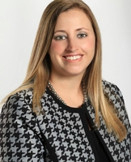
Innovative membership & club approaches
District Membership Committee Member
Two-time Rotary Club President, Founding member of the Family Forward Rotary Club, DeLand Sunset
Serves on the District 6970 Policies and Funds Board
Assistant Governor, Area 10, awarded the Avenues of Service Award
Managing Attorney at Landis Graham French
Brittany Gloersen

Slide 45

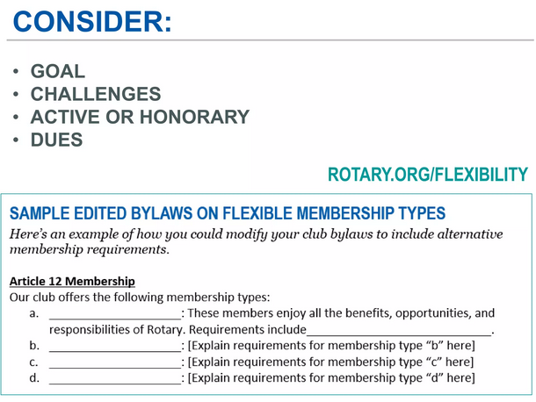

Membership Types
Membership Types
Family Membership
Corporate Membership
Young Rotary Leader Membership
Community Membership

Slide 46


GROW ROTARY MORE QUICKLY
Satellite / IMPACT & Companion Clubs

Slide 47




5 BENEFITS OF FORMING NEW CLUBS:
Grows Rotary more quickly
Retains members longer
Attracts younger & more diverse members
Makes Rotary more visible
Increases partnership opportunities
Notes:
Grows Rotary Quicker
Retains Members Longer
Attracts Younger Members
Reaches Out into the Community
Cause-based Clubs Increase Partnership Opportunities

Slide 48

INTEREST-BASED
DIFFERENCE | Focuses on a particular interest or hobby
FOR | Rotarians wanting to enjoy Rotary in a specific way
ACTIVITIES | Projects aligned with interest
FUELED | By members’ interests
EXAMPLE | The Rotary Club of Southeast Volusia Golf
Notes:
An interest club is like a cause-based club; but, instead of focusing on a cause, they focus on an interest or hobby. existing club can adopt this model
The sky is the limit!
My DG Classmate in Australia is starting a club focused on Kola.

Slide 49
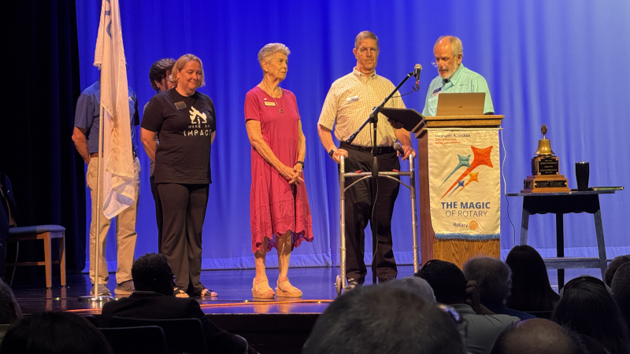
CAUSE-BASED
DIFFERENCE | Focuses on a particular cause
FOR | People who want to connect with others while focusing on a particular issue
ACTIVITIES | Projects & speakers are related to the cause
FUELED | By members’ passions & community’s needs
Notes:
This is my favorite type of club because you can add it to an existing club or a new club and people passionate about a cause are highly motivated to make things happen. Also, a cause makes people stay members!
The most common are:
- Eco Clubs
- Veterans Clubs
- End Human Trafficking Clubs
It is about the service. Not required to be a member of the group being served. Inclusive in terms of membership. Only Exclusive in terms of service. You do not have to be a vet to be in the veterans club – you just have to want to serve vets and/or their families.

Slide 50
  Define your vision
  Develop a plan
  Bring in all impacted parties
  Gain BOD approval
  Launch
Satellite ClubS
The easy steps to launch

Slide 51



5 KEYS TO SUCCESS
A PASSIONATE CHAMPION
CAMARADERIE / FRIENDSHIP
SHARED DESIRE TO SERVE
STARTED WITH FRIENDS
NURTURED BY A CLUB OR DISTRICT
Notes:
All of the new and innovative clubs that were discussed today have five things in common and these five are the keys to success . . .

Slide 52
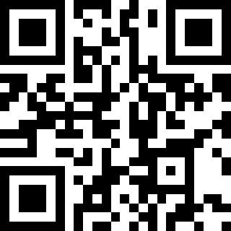

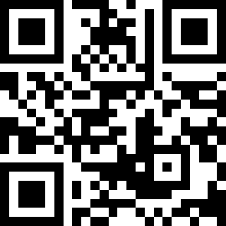
Guide to starting a Satellite Club
Steps to build a Companion Club
Available resources

Slide 53
QUESTIONS

Slide 54
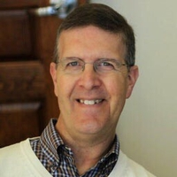
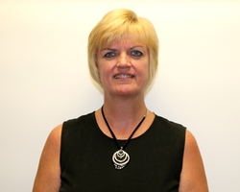
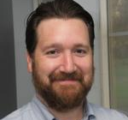
Herb Silverman is the founder and current President of the Rotary Club of IMPACT Ocala, which transitioned from a Satellite Club to a free-standing club last year. After nearly 3 decades in management, marketing, and sales, he has embraced retirement now dedicated to volunteering, networking, and blogging. Staying connected to his Ocala community is a priority and he actively participates in various committees and local charities to make positive results. He cherishes moments spent making meaningful connections with both old and new friends, believing that every interaction has the ability to inspire and transform.
IMPACT Ocala
Anne Cartier is the current President of the Rotary Club of Debary, Deltona, Orange City. She relocated to Deltona in 2020, joined her current club and has consistently held several different leadership roles. A mother of two daughters, she has been deeply involved with community and youth organizations. She devoted 13 years to the Edison Festival of Light in various leadership roles, including President. She has decades of expertise in the fields of insurance sales and marketing, leading several teams across high-tech, publishing, and manufacturing sectors.
Debary, Deltona, Orange City
Jerry Pryor is the Membership Chair for Amelia Island Sunrise. With others, he instituted the flexible membership type of Active Community which has been adopted by the District as a pathway for clubs to transition to Companion Clubs. He has practiced law in Boston and Washington DC. He worked on a number of regulatory issues involving wireless service providers and also clerked for a former FCC Commissioner. He joined Harris Guidi Rosner PA in 2018 and represents disabled and injured clients in Social Security disability and worker’s compensation claims.
Amelia Island Sunrise
Brittany Gloersen is the founding member of the Rotary Club of DeLand Sunset, a family forward Rotary effort focused on making Rotary more inclusive for families. Currently she serves on the Policies and Funds Board for the District. She has served as a Rotary Club President twice for two different clubs and has served as the Area 10 Assistant Governor. As AG, her area clubs reached 100% of their goals resulting in her Avenues of Service Award. She is a Managing Attorney and proud mom to son Gray.
DeLand Sunset
Notes:
…..

Slide 55
QUESTIONS

Slide 56
Wrap up / evaluations
District 6970 Rotaract Focus Person for the Membership Committee
Over five years of professional experience in the event industry
Actively involved in Junior Service League of DeLand, current Chair of Grand Marshals for the 2026 Wild Wild West event
Home club, Rotaract Club of DeLand
Served 2 years as Club Membership Chair
Chanelle Taylor

Slide 57
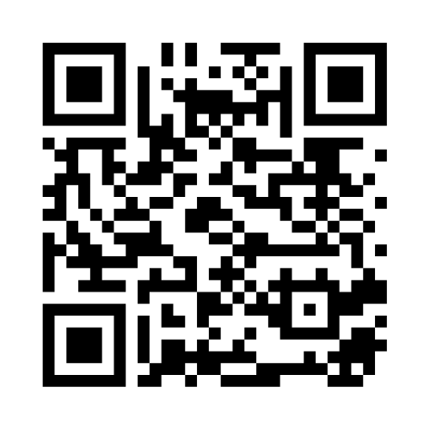
Please TAKE OUR quick MEMBERSHIP SUMMIT SURVEY

